Slide 1


COP3252
Project
Trevor Alspach ◉ Kaitlin Tran ◉ Benjamin Zech

Slide 2
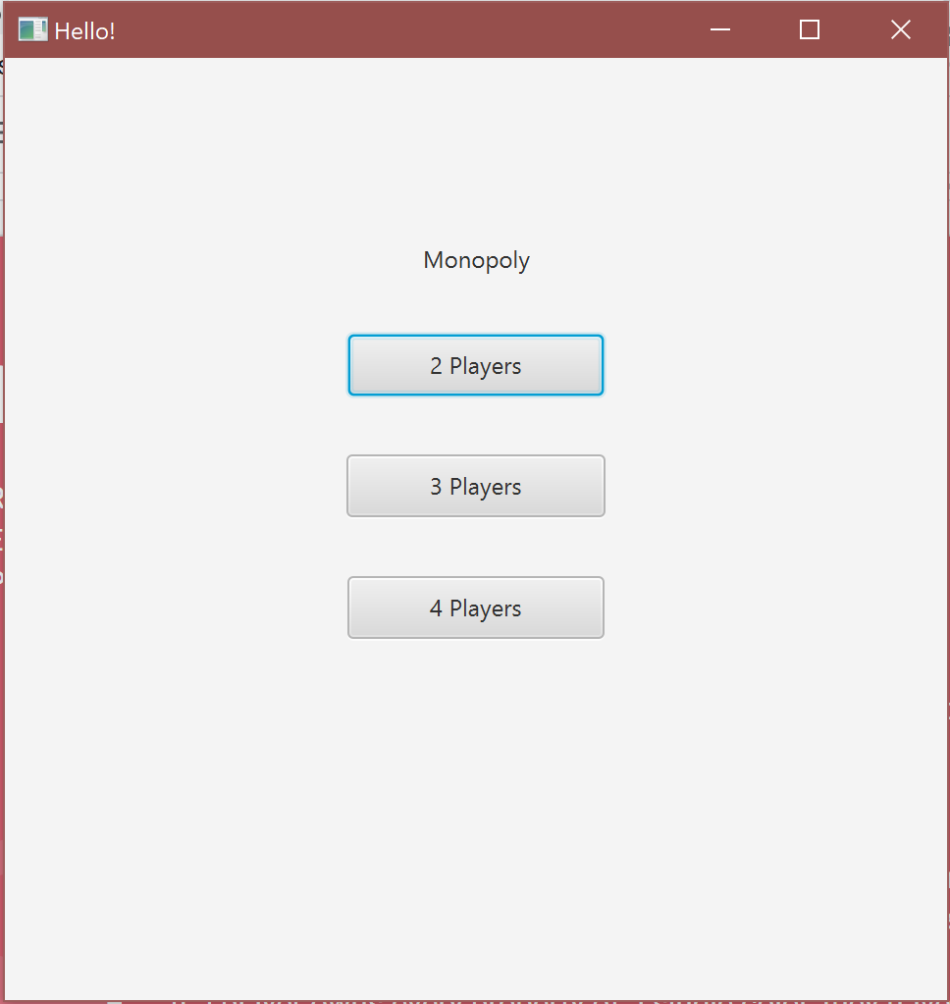




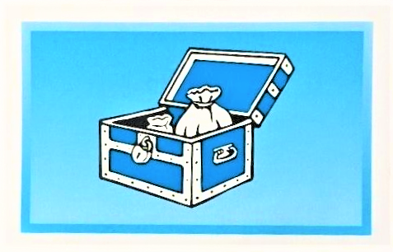



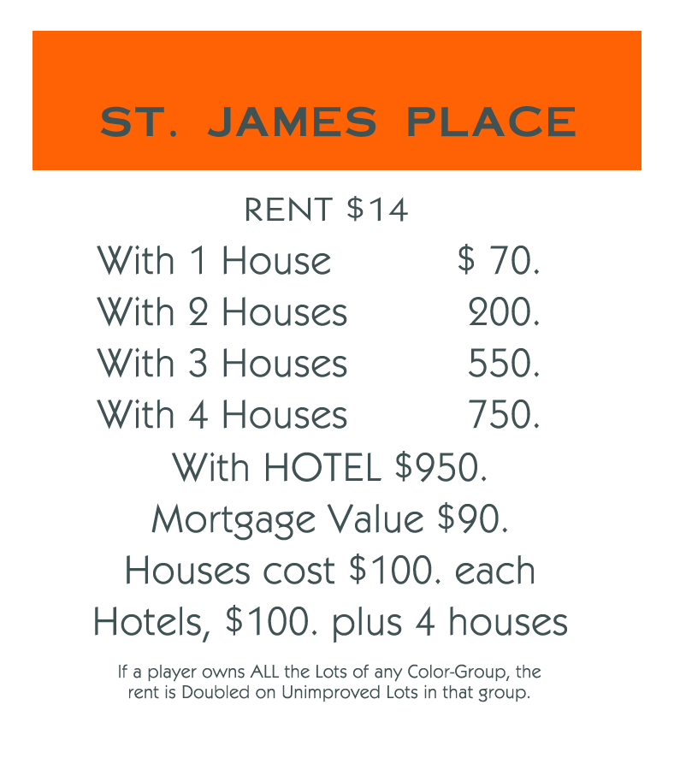
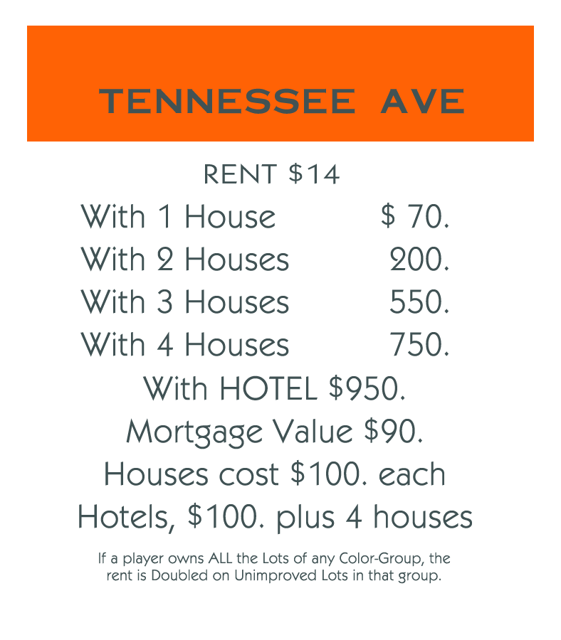
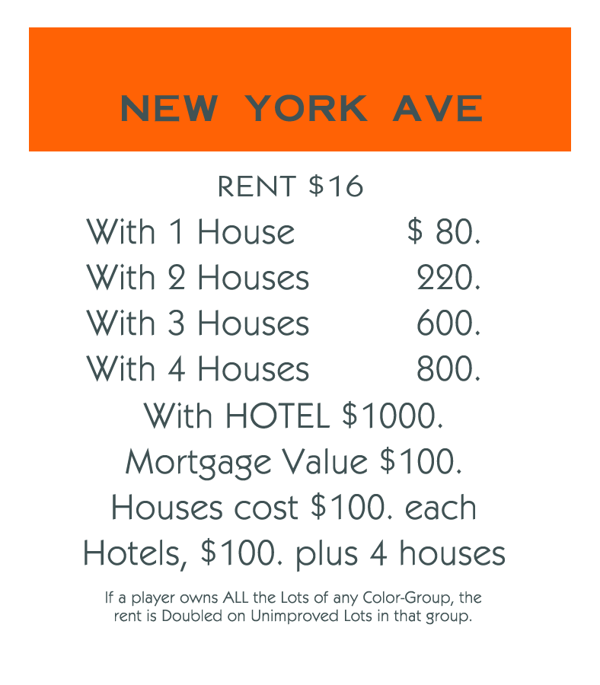
Rules of Monopoly
Requires 2-4 players
Each player starts off with $1500
Players begin at the “Go” space and move clockwise around the board (contains 40 spaces)
Wild cards
If a player lands on a chance or community chest space, they must draw a chance/community card from the deck and follow directions.
Jail
Players in jail cannot play until they pay $50 bail.
Owning property
If a player lands on an unowned property, they have the choice to buy it using money.
If a player lands on an owned property, they owe the owner of the property rent money.
Monopoly
If a player owns every property of a single color, they have a monopoly. Rent is doubled.
Players that own monopolies can build houses and hotels on properties to increase rent.
If you run out of money, you’re out. Winner is the last player standing
Notes:
Kaitlin

Slide 3
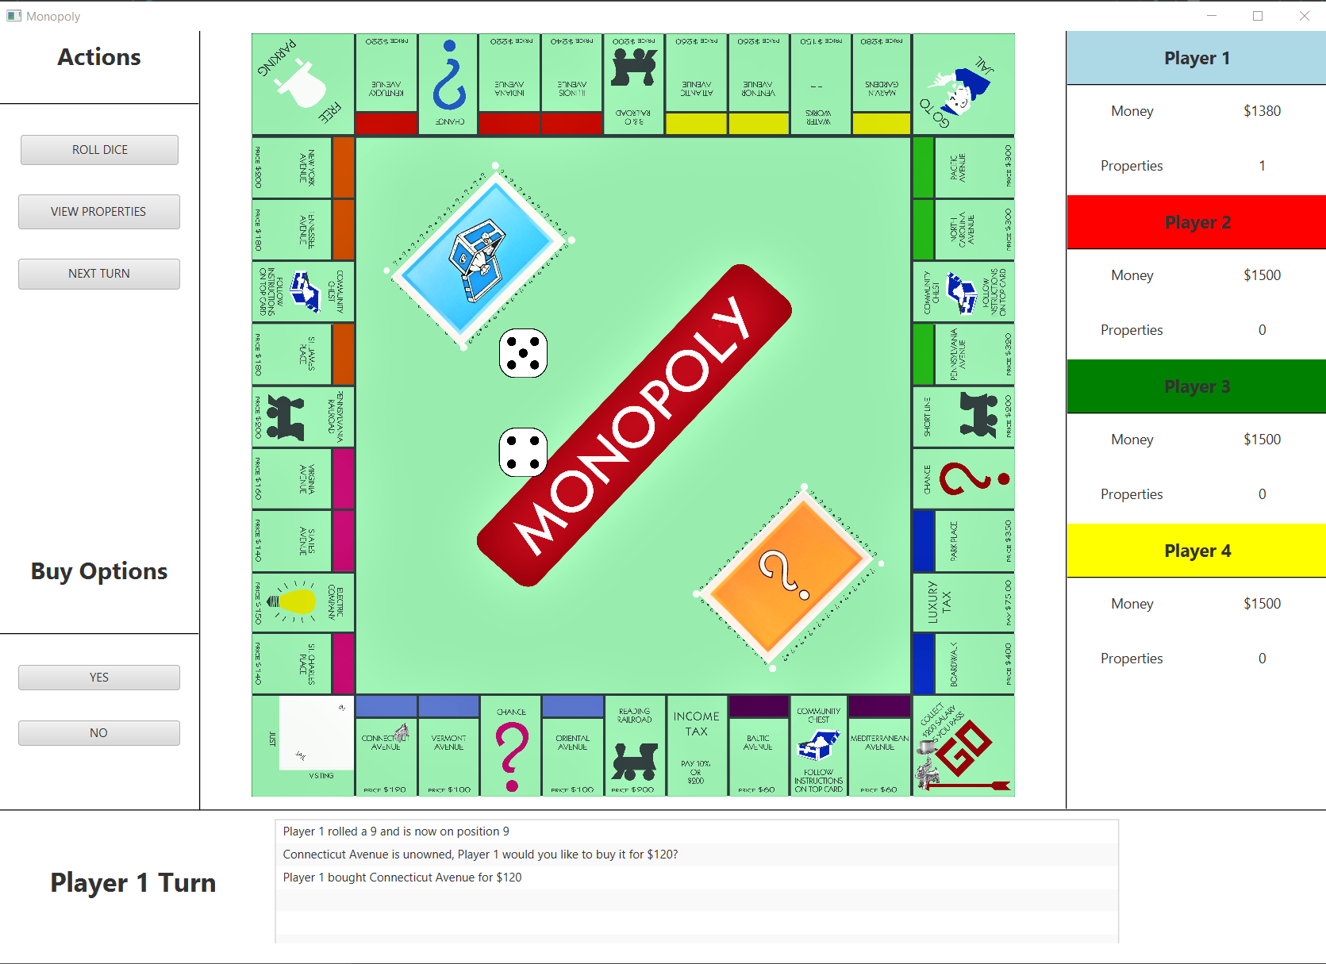
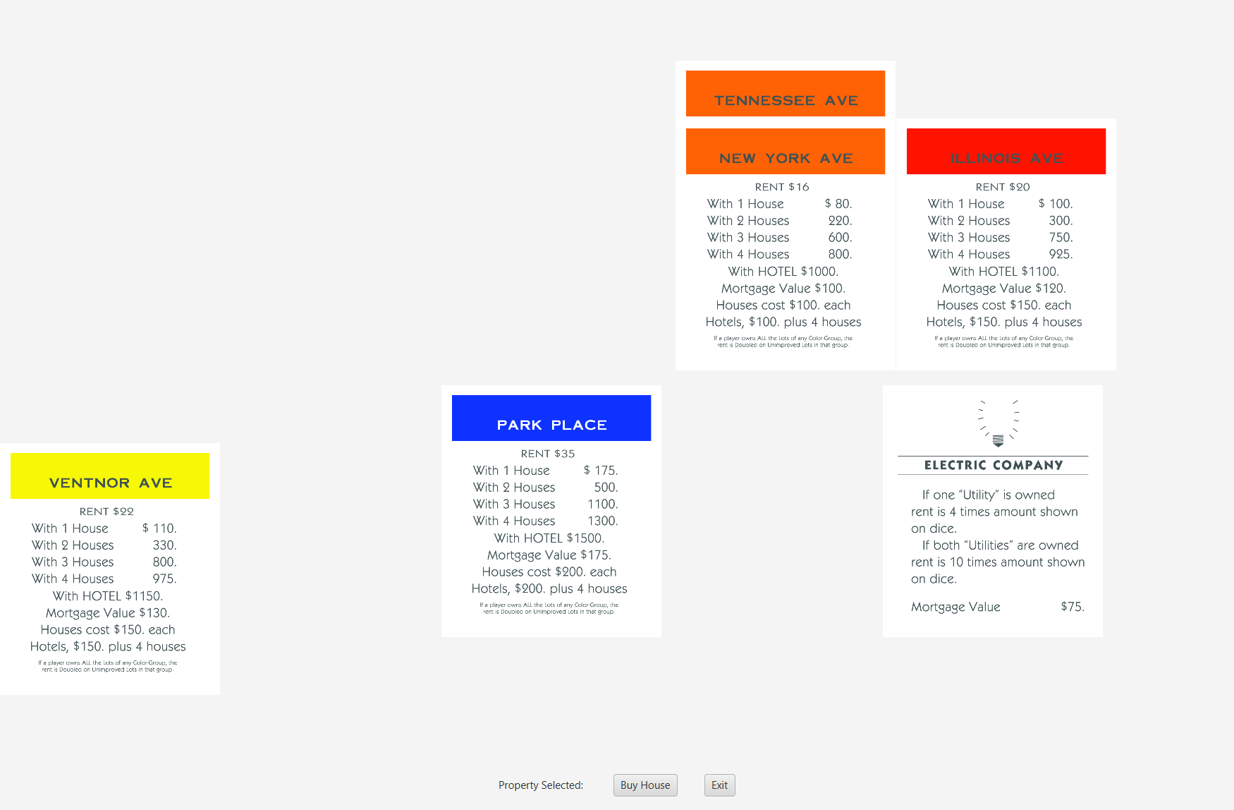
How to Play
Roll 2 dice to move spaces by using the “Roll Dice” button.
If you roll doubles, you can roll again.
If you roll doubles 3 times, you go to jail.
If you land on an unowned space, you will be prompted with the question to buy the property.
Select “yes” means you pay the price and own the property.
You can view your properties in a separate tab with the “View Properties” button.
You can buy houses and hotels in this tab once you own a monopoly of properties.
If you land on an owned space, you automatically pay rent to the owner.
If you are in jail when your turn begins, you will automatically pay the $50 bail.
If you land on a chance or community chest space, the effects of the card will automatically take place.
If you are done with your turn, click the “Next Turn” button.
Notes:
Kaitlin

Slide 4
Window Controllers
We used JavaFX for our UI, with an MVC design pattern.
Window Controllers hold the logic for manipulating our models based on particular UI events.
MainWindowController.java
StartWindowController.java
ViewPropertiesController.java
Windows
FXML files control the display of the windows.
Includes elements such as ImageViews and Buttons which are manipulated via the Controller.
main-window.fxml
start-screen.fxml
view-properties.fxml
Notes:
Trevor

Slide 5
Models
Player
Property
Dice
ChanceCard
ChanceCardsDeck
CommunityCard
CommunityCardsDeck
Notes:
Trevor

Slide 6

public class Player
private int currentBalance;
private int currentPosition;
private int playerID;
private int getOutOfJailCards;
private int numProperties;
private boolean inJail;
Notes:
Ben Zech

Slide 7
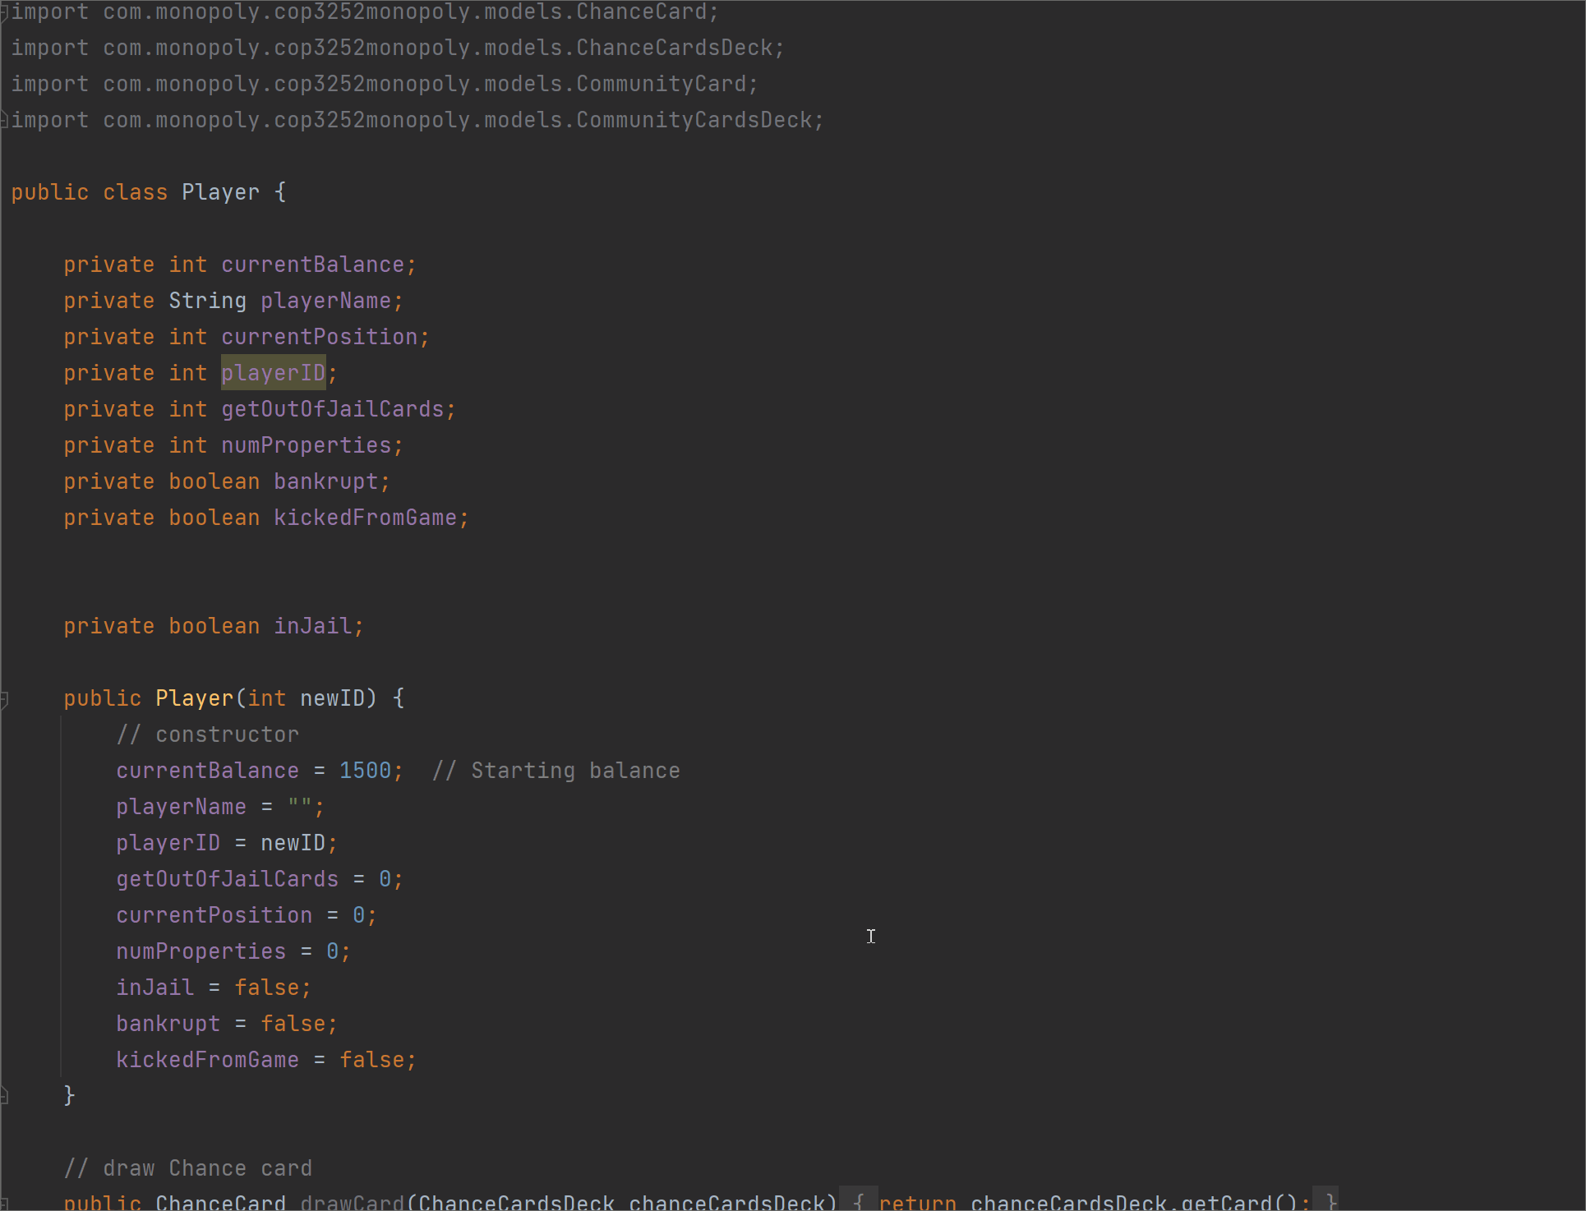
Player.java
Player
Property
Dice
ChanceCard
ChanceCardsDeck
CommunityCard
CommunityCardsDeck
Notes:
Ben Zech

Slide 8
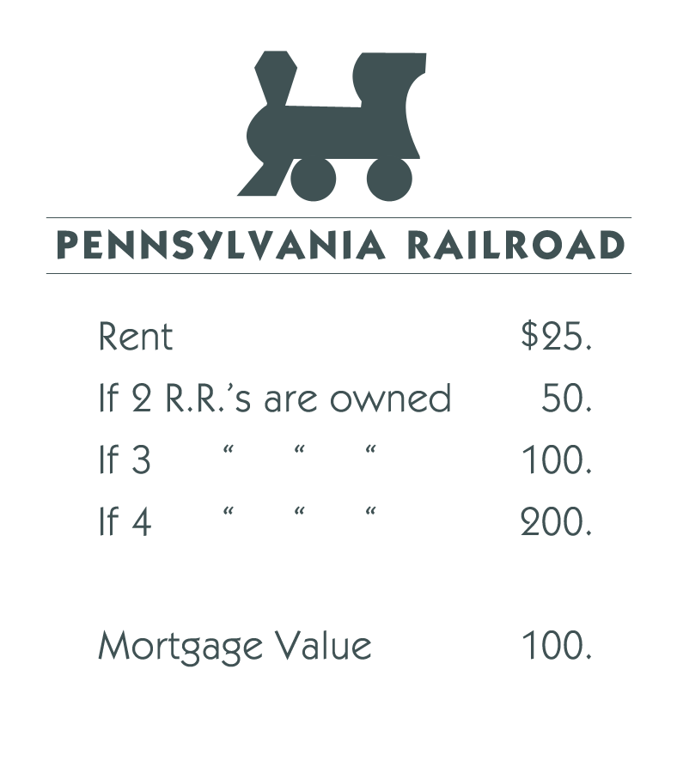
public class Property
private int propertyCost;
private boolean isOwned;
private int owner;
private String propertyTitle;
private int houseCount;
private int houseCost;
private boolean isRailroad;
private boolean isUtility;
private int boardPosition;
Includes 2 static HashMaps
propertyValues (for rent values)
Integer -> ArrayList<Integer>
propertyNames (for property names)
Integer -> String
Notes:
Trevor

Slide 9
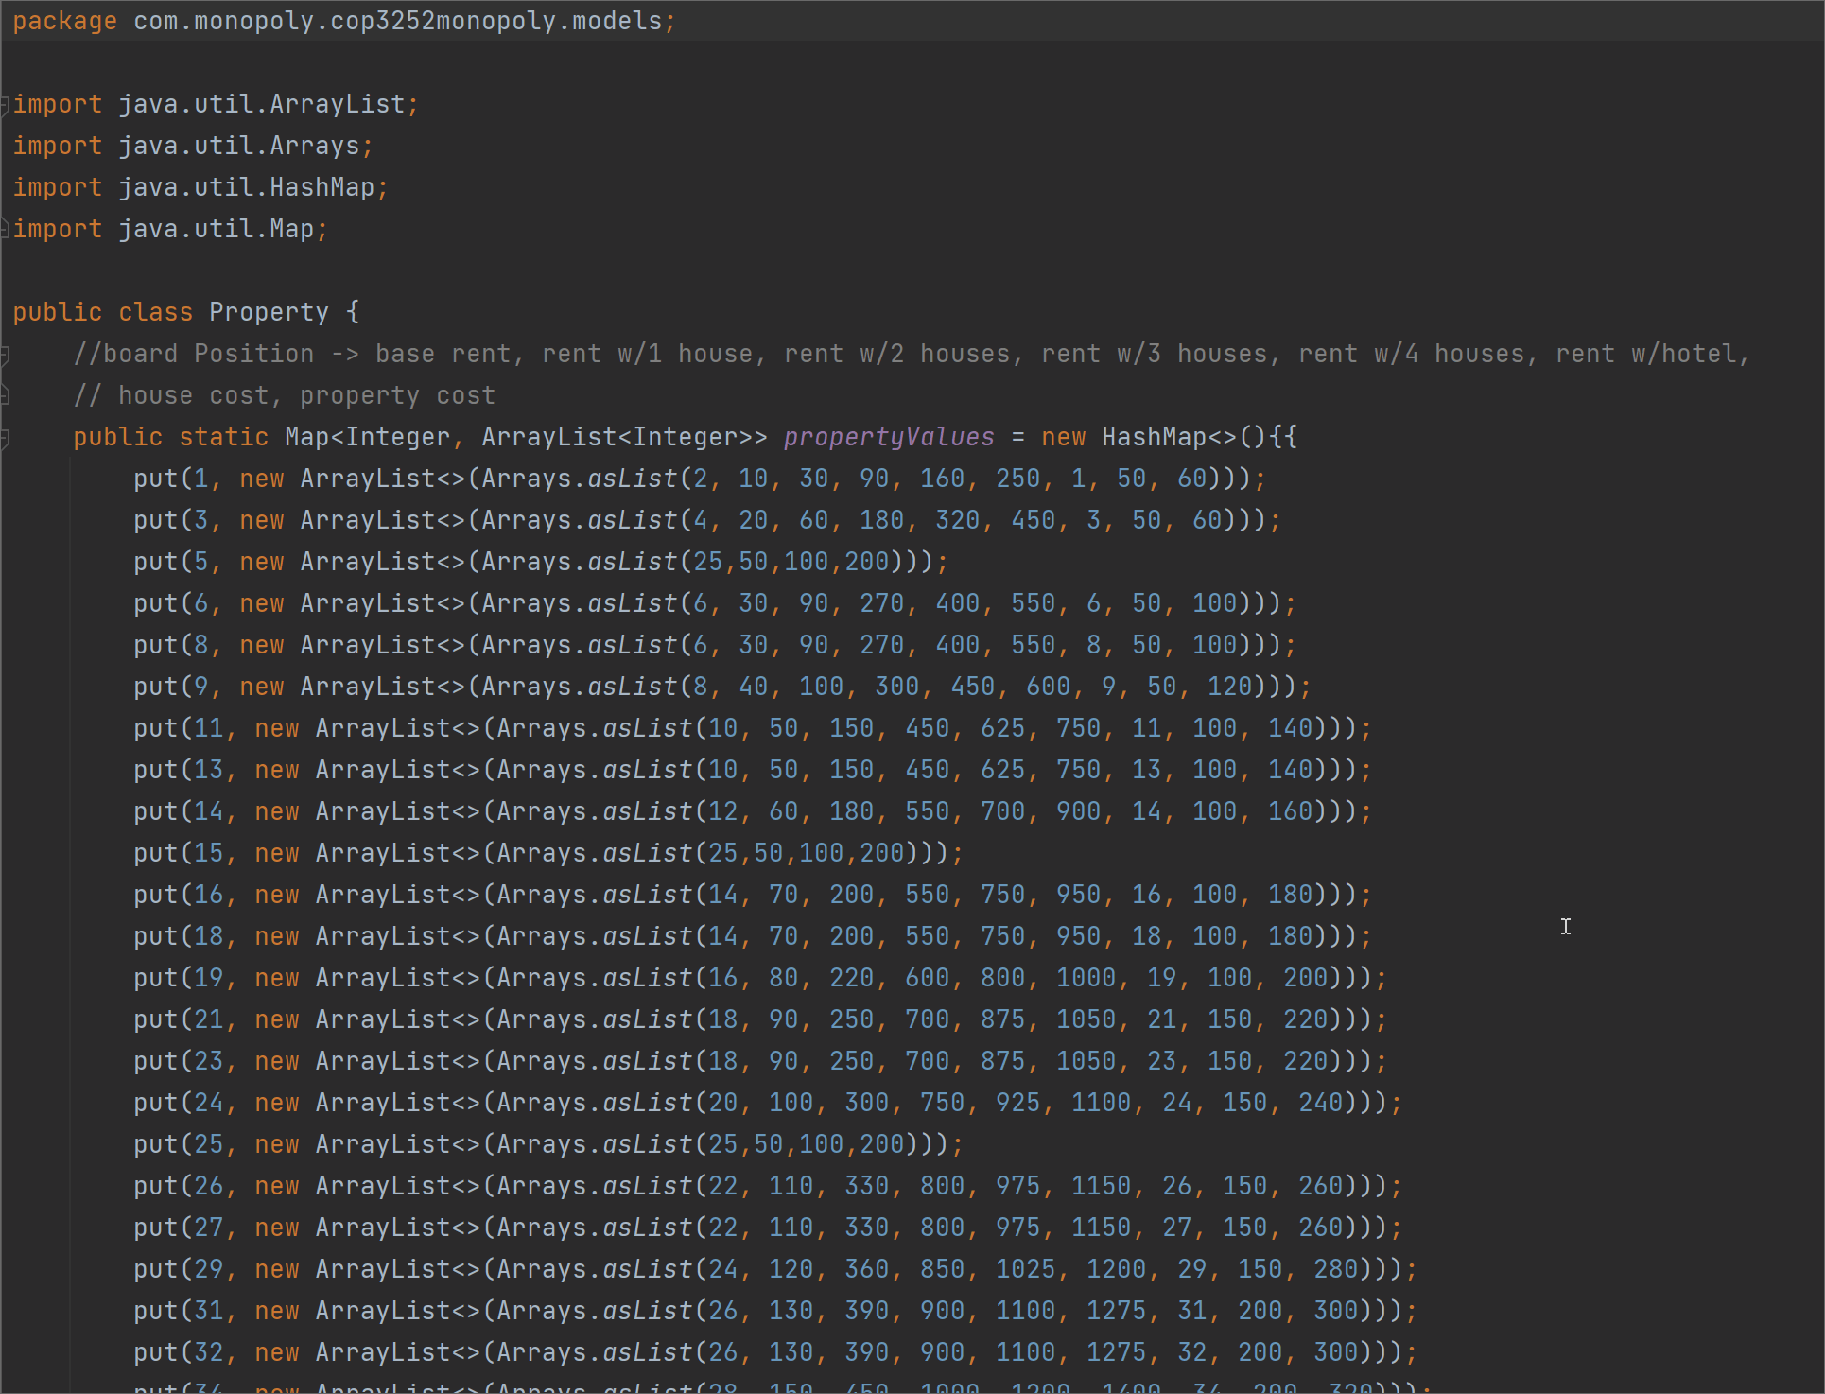
Property.java
Player
Property
Dice
ChanceCard
ChanceCardsDeck
CommunityCard
CommunityCardsDeck
Notes:
Trevor

Slide 10
public class Dice
final private int[] dice1;
final private int[] dice2;
private int lastRoll;
private int DEBUGdice1;
private int DEBUGdice2;
private Random random;
private int doublesCount;
Notes:
Kaitlin

Slide 11
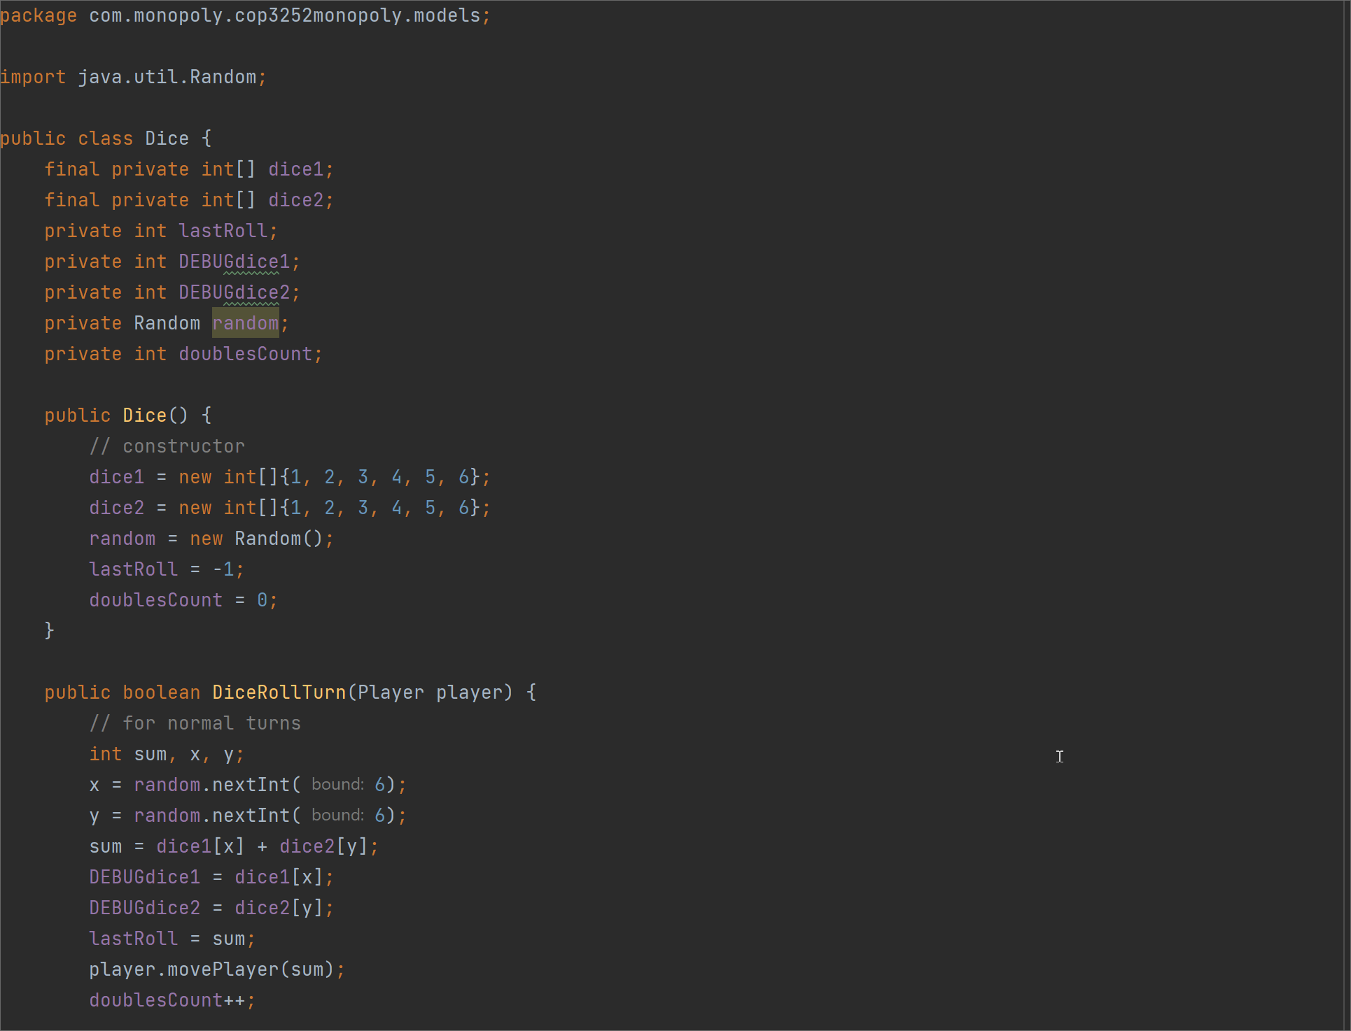
Dice.java
Player
Property
Dice
ChanceCard
ChanceCardsDeck
CommunityCard
CommunityCardsDeck
Notes:
Kaitlin

Slide 12
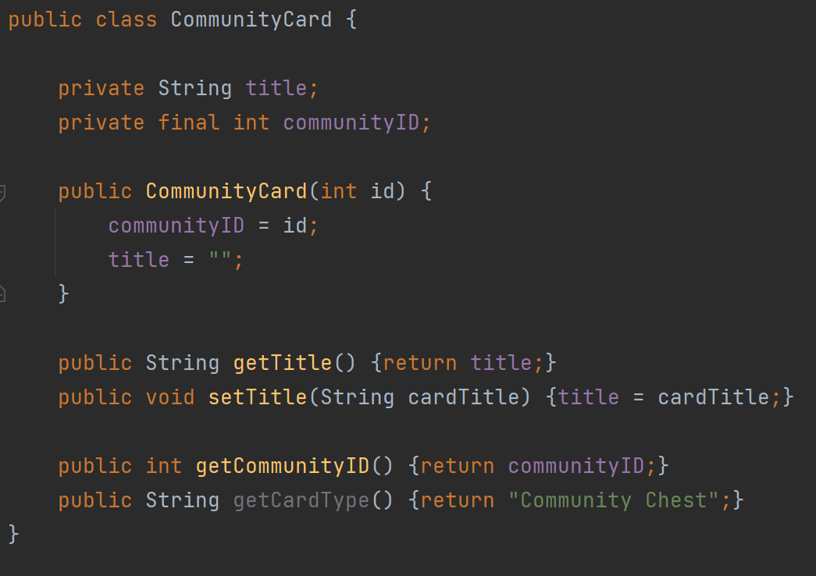
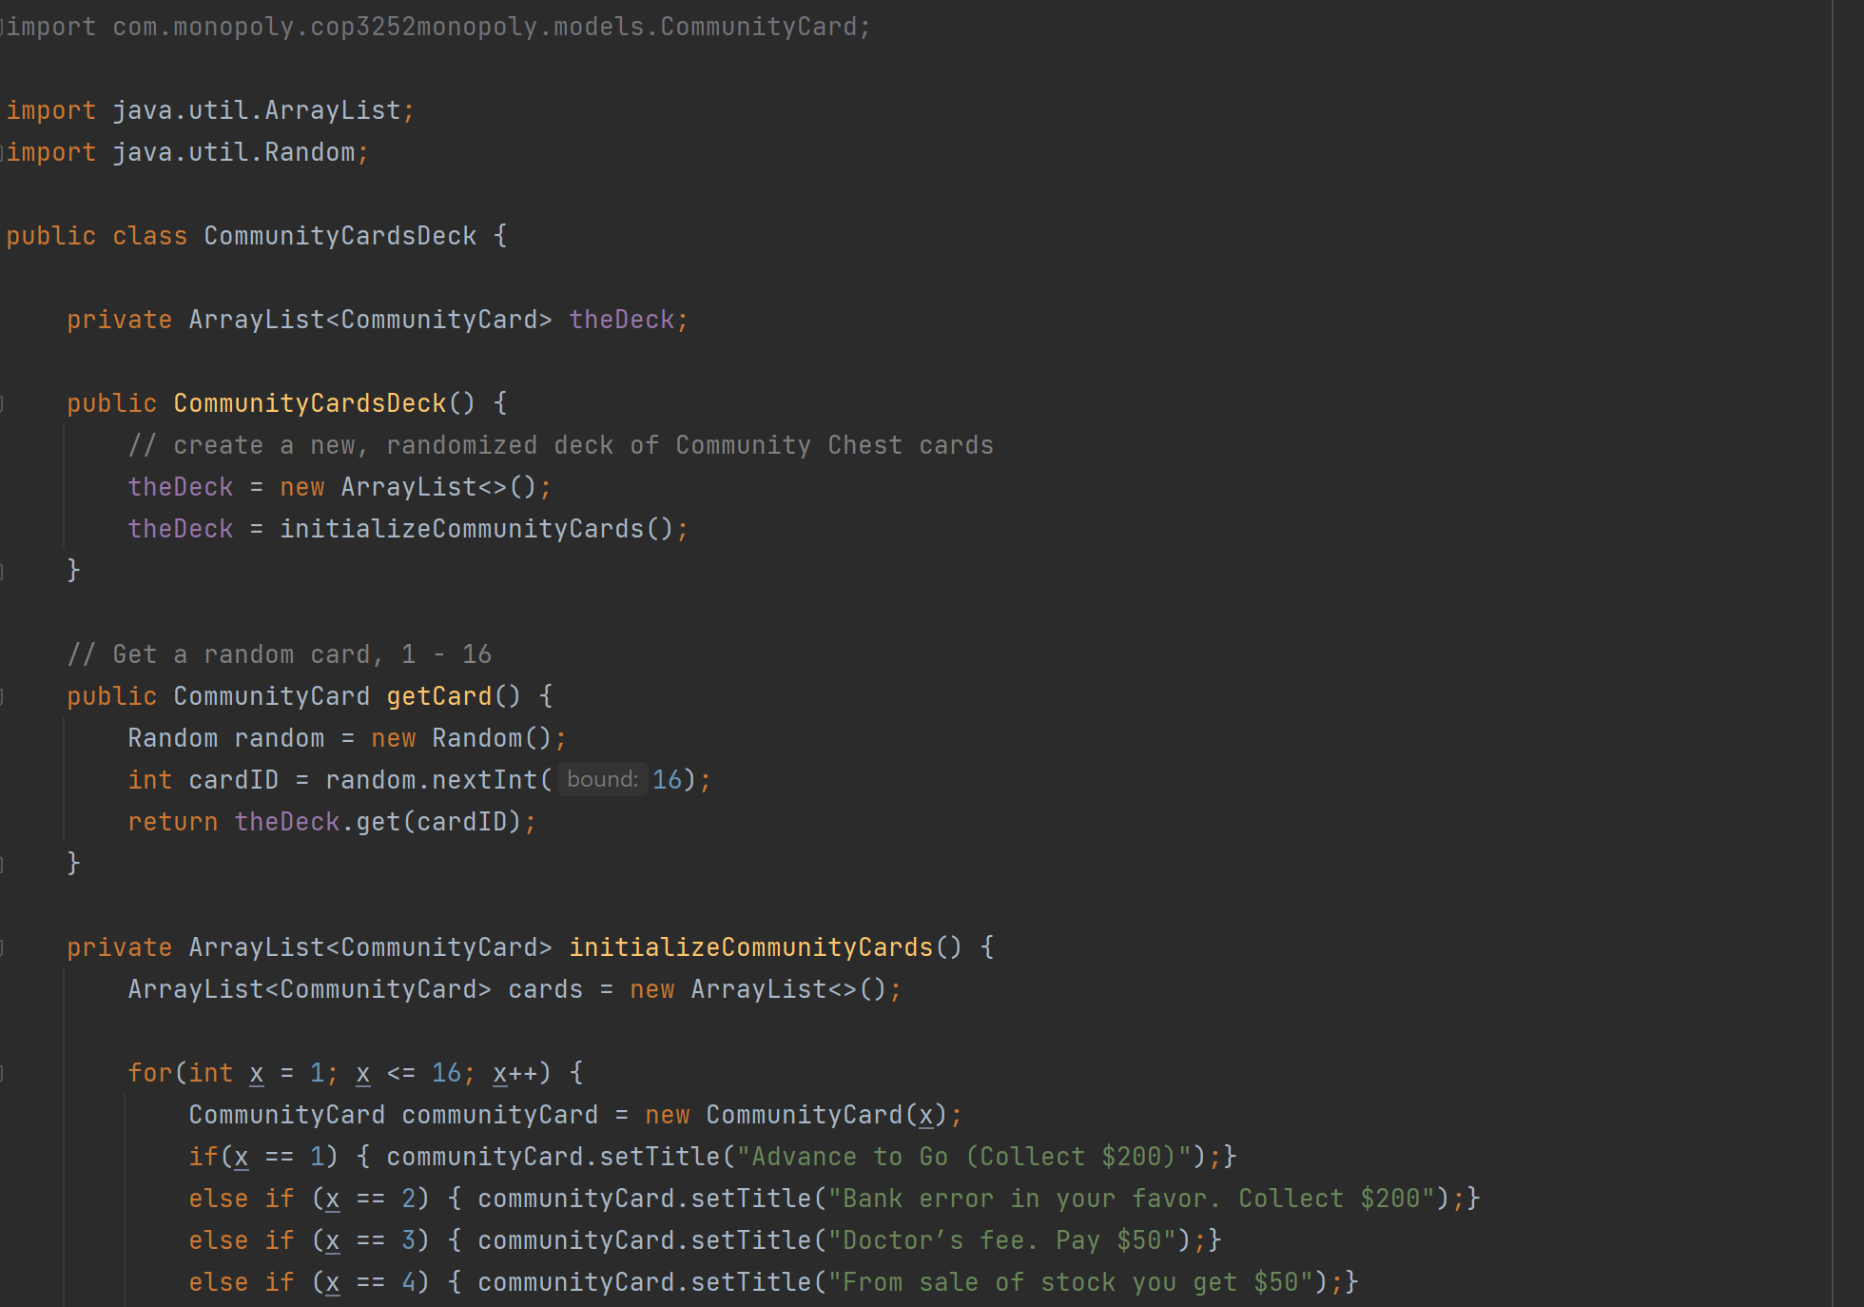
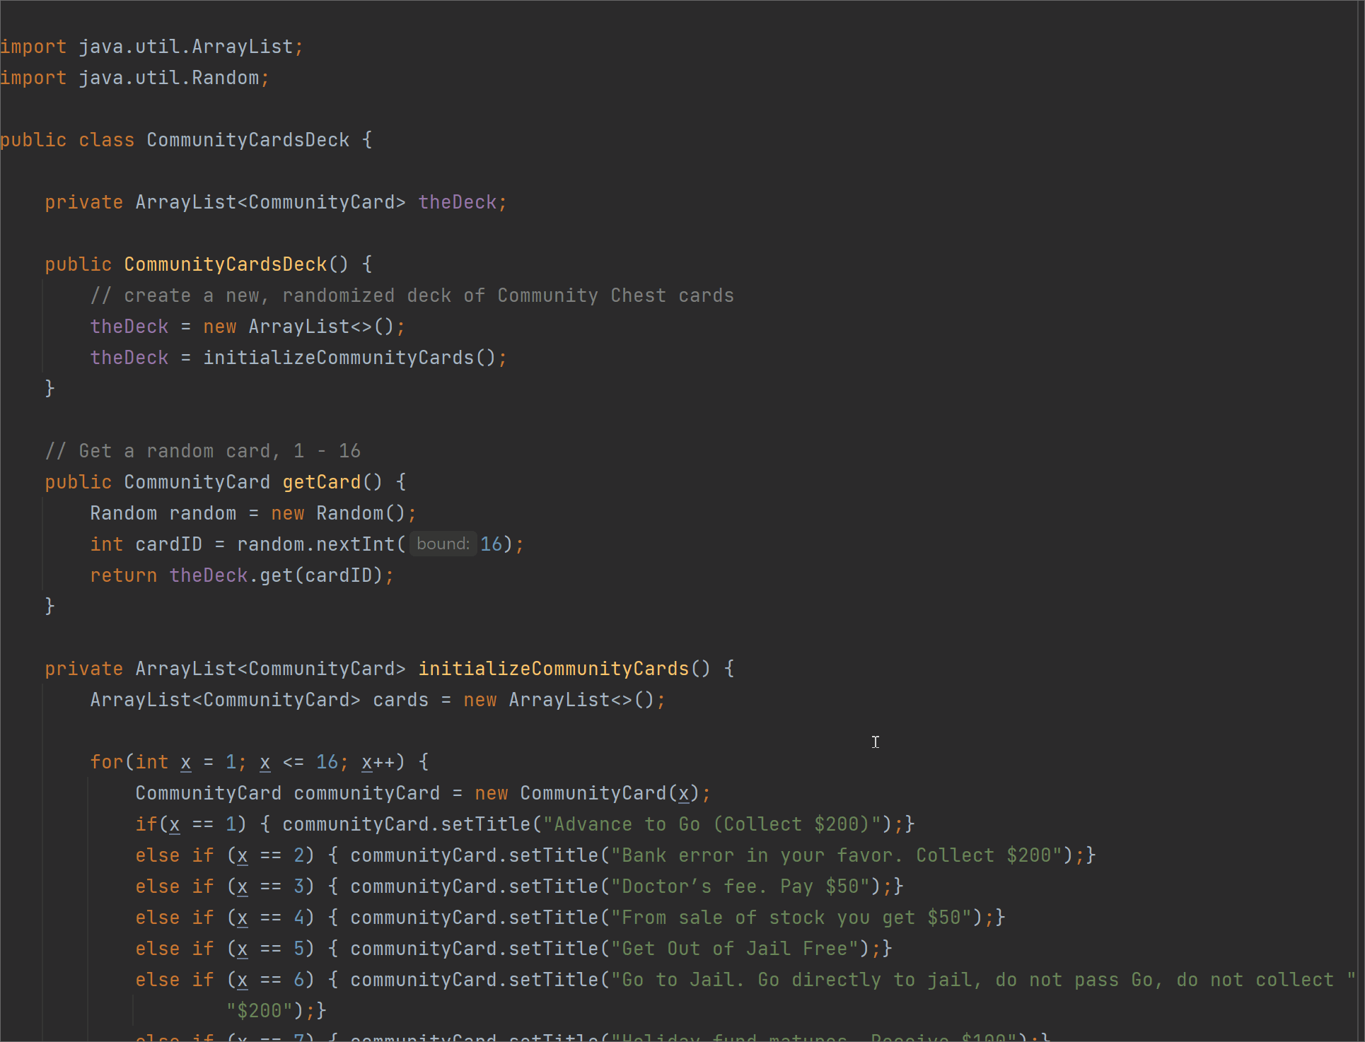
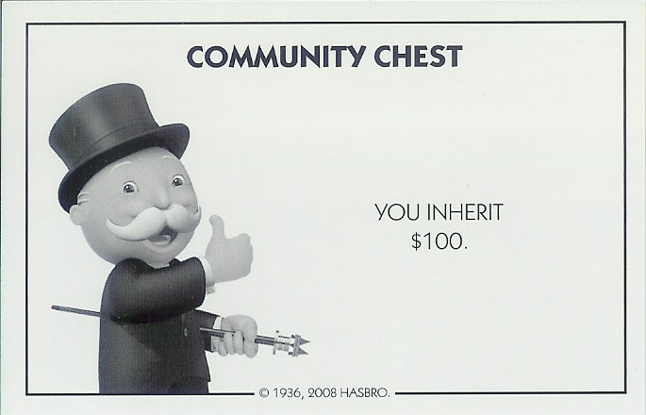
Community Chest Cards
public class CommunityCard
public class CommunityCardsDeck
Creates an ArrayList of Community cards
Notes:
Ben Zech

Slide 13
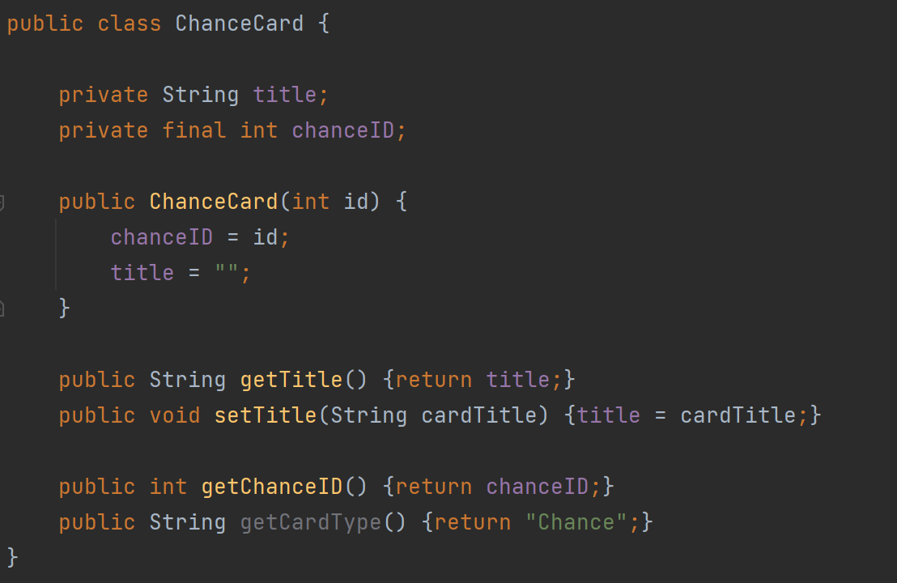
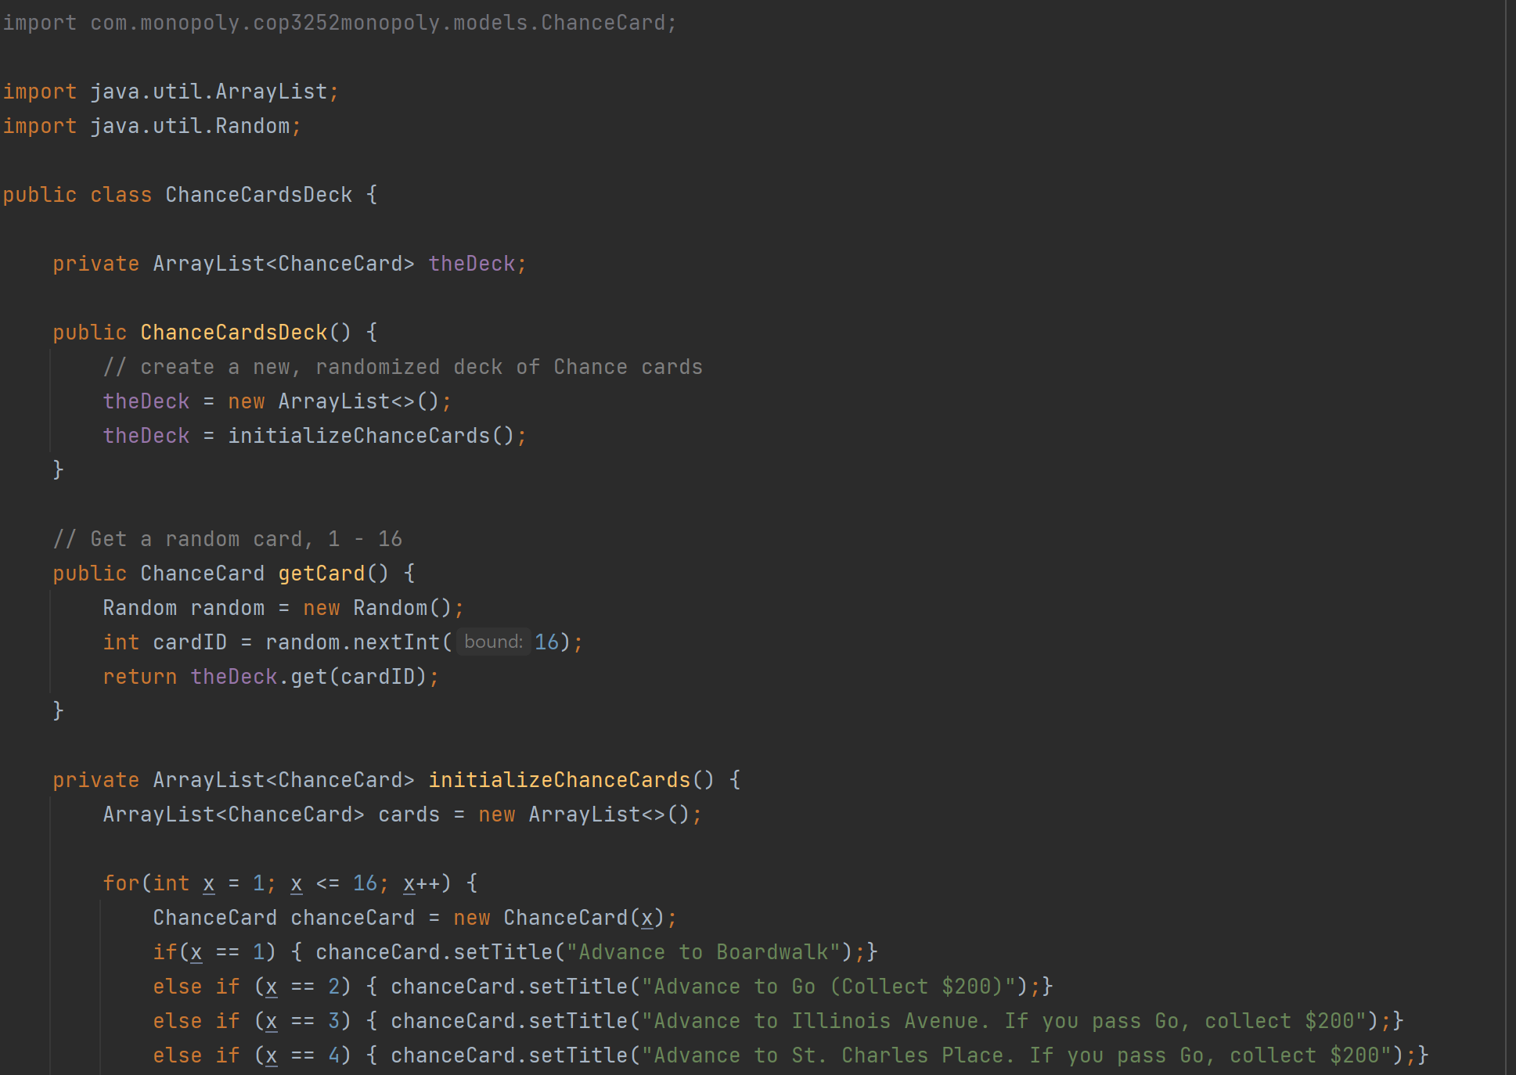
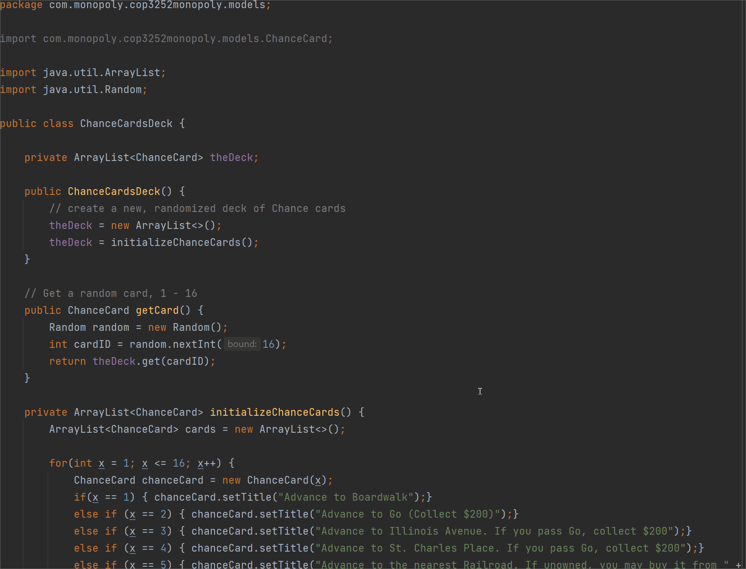
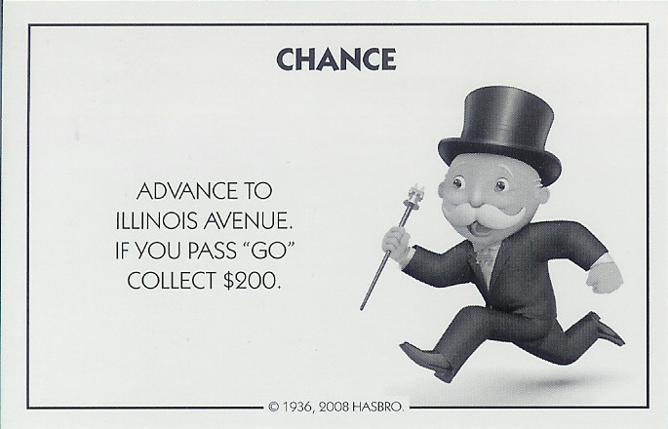
Chance Cards
public class ChanceCard
public class ChanceCardsDeck
Creates an ArrayList of Chance cards
Notes:
Ben Zech

Slide 14
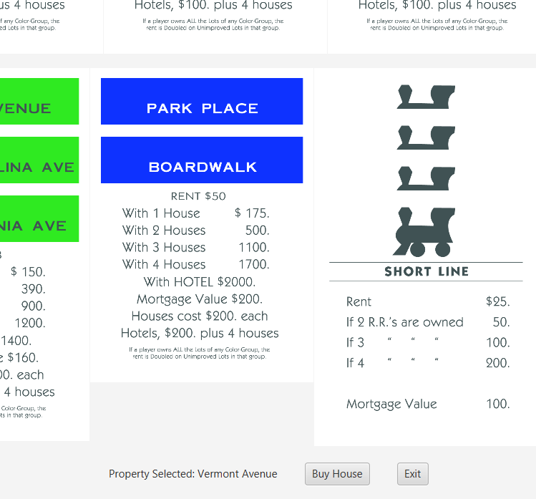
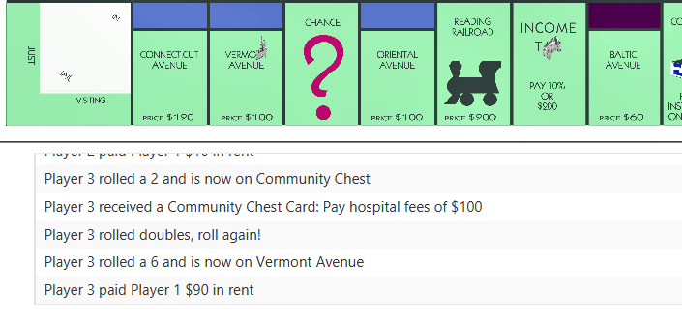
Rent & Houses
If a player has all the properties for a color, they can add houses via the View Properties screen.
Click on the image of the property, then the Buy House button.
In this case, Player 3 landed on a property where Player 1 put a house, and pays increased rent
Notes:
Trevor

Slide 15
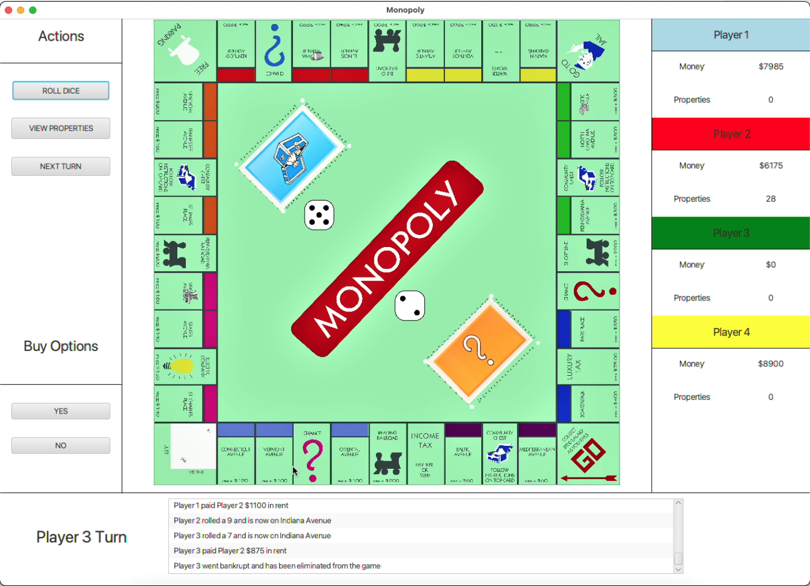
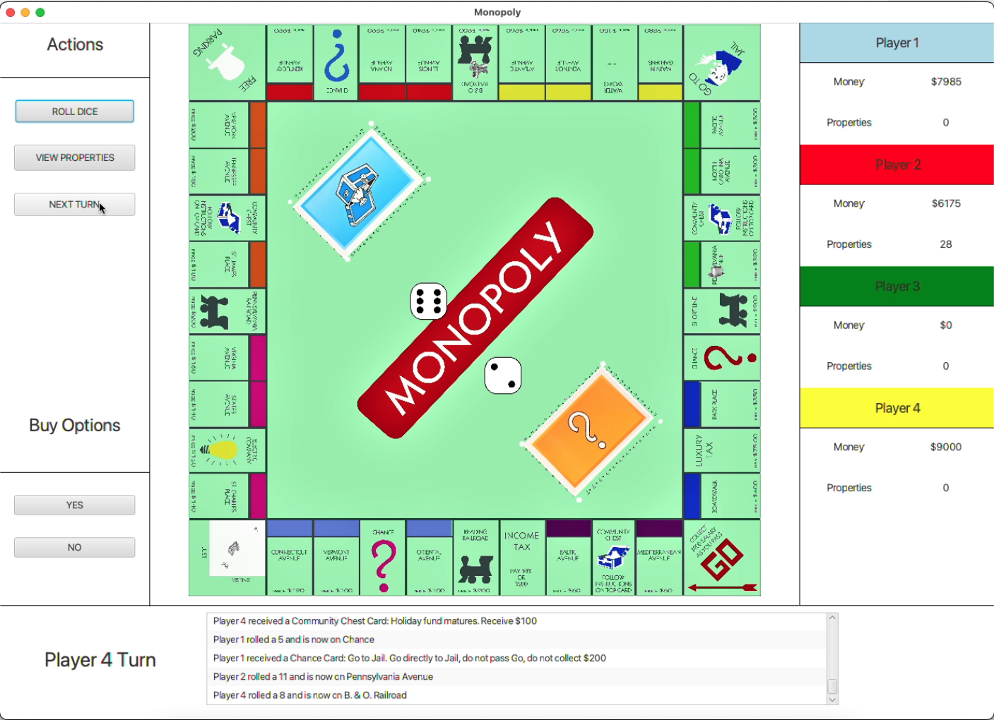
End Game
When a player loses all of their money, they are ejected from the game
All of the bankrupt players’ properties are put back up on the market for other players to buy
The game continues until there is only 1 player left
Notes:
Ben Zech

Slide 16
Live Demo
Player 1
Player 2
Player 3
Notes:
Trevor

